Slide 1

CAB BOOKING AND RENTAL MANAGEMENT SYSTEM
OOPs Project
Team Members:
Bornil Gogoi (2312176)
Kunal Rajesh Sangalge (2312182)

Slide 2

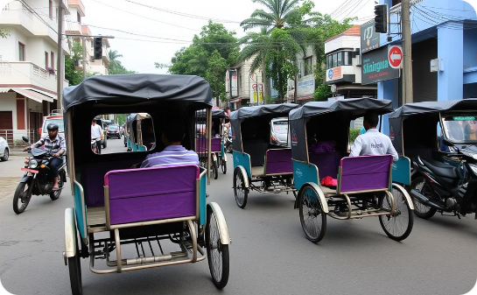

Problem Statement
Metro cities enjoy the convenience of app-based cab services.
Silchar faces transport inequality with informal rickshaws dominating mobility.
How can we design a reliable, offline, user-friendly cab and rental system for Silchar and NIT Silchar residents?

Slide 3
Our Offline-First OOP Solution
We engineered a C++ system that replicates ride-hailing functionality without internet dependency, using object-oriented design to address Silchar's unique challenges.
Structured Data Management
CSV files emulate database functionality
Encapsulated file operations ensure data integrity
Geospatial Intelligence
Haversine formula calculates real-world distances between NIT Silchar and key locations
Dynamic driver matching within 1km radius (optimized for Silchar's urban density)
User-Centric Design
Input validation protects against invalid bookings/registrations
Clean CLI interface modeled after commercial systems

Slide 4
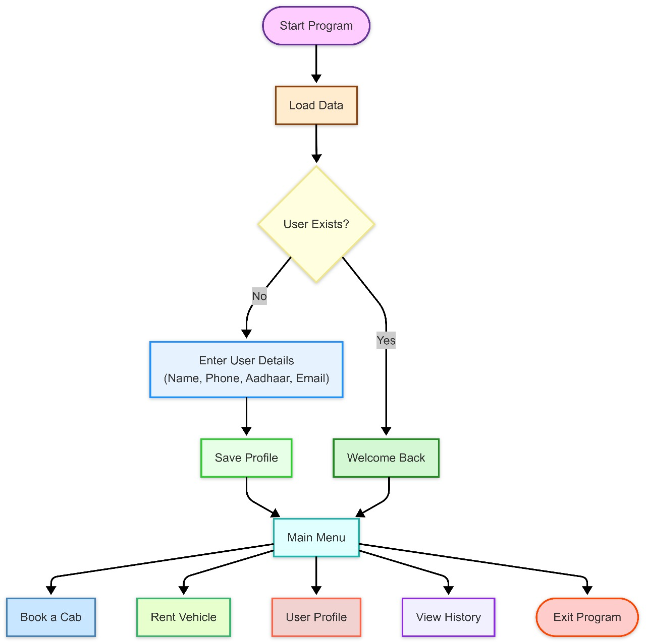
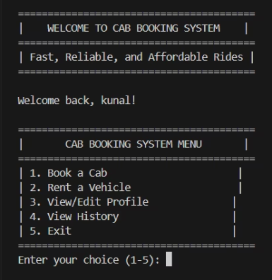
Program Workflow
Start → Load Data
User Authentication:
New user: Register (Aadhaar/phone validation).
Existing user: Load profile.
Main Menu:
Book Cab | Rent Vehicle | View History | Edit Profile.

Slide 5
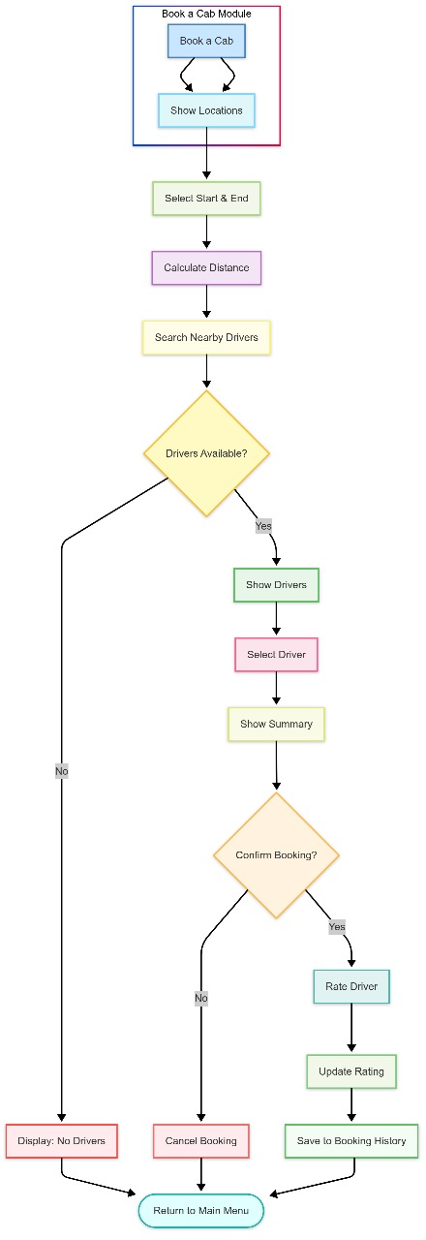
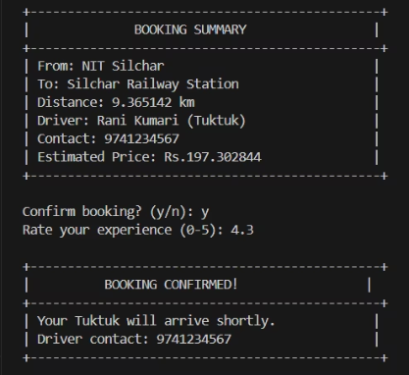
Cab Booking Module
Select Locations : Predefined Silchar Locations
Calculating Distance: Haversine formula.
Driver Matching: Proximity-based
Fare confirmation and Confirmation:
Fare = Distance × Vehicle rate.
Rate driver post-ride.
History Update

Slide 6
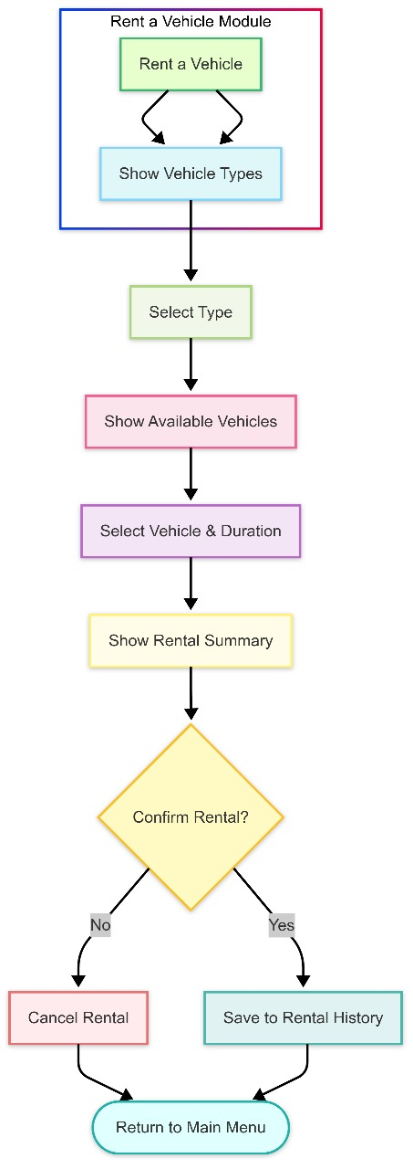
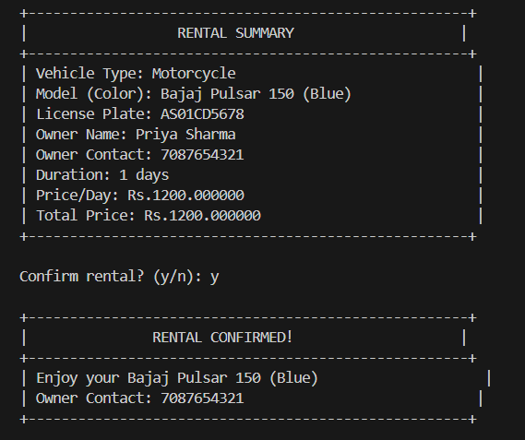
Vehicle Rental Module
Choose Vehicle Type
Select Duration
Confirm Rental
History Update

Slide 7
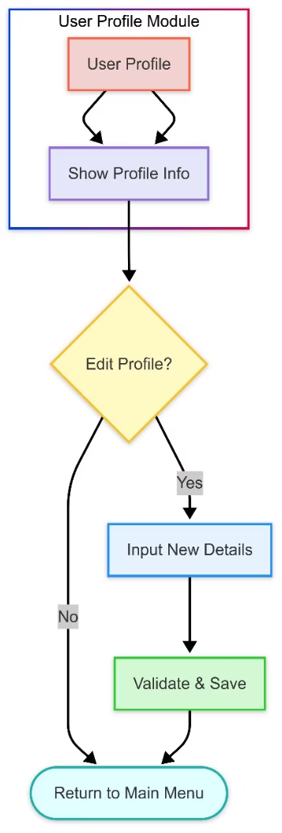
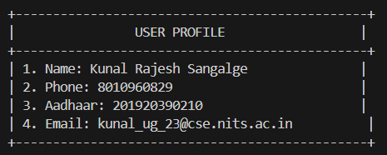
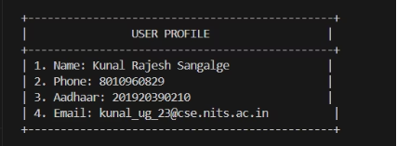
User Profile Module
Key Features:
Profile Display:
Shows saved details: Name, Phone , Adhaar, Email
Edit Profile:
Options to edit any field
Input Validation:
Phone (10 digits)
Adhaar (12 digits)
Data Persistence
User Profile Module
Key Features:
Profile Display
Edit Profile
Data Persistence

Slide 8
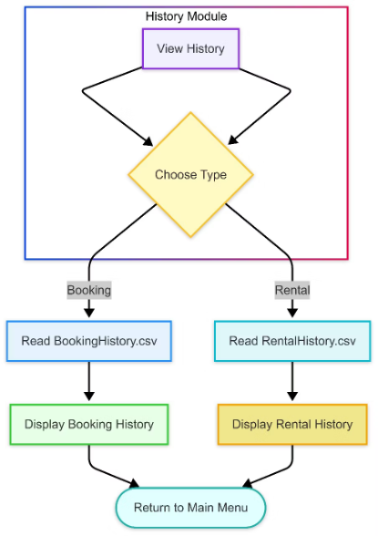
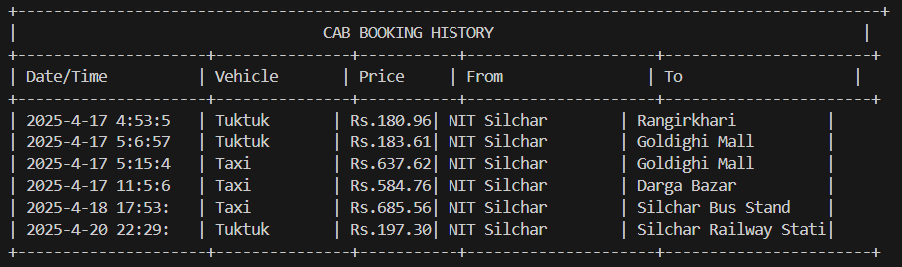
History Module
Dual Logs:
Booking History: Source, destination, fare, driver
Rental History: Vehicle type, duration, cost
User Friendly Display:
Tabular Format with headers

Slide 9











Encapsulation
Bundling data and methods into a class, hiding internal details. (🔒 Secure & Organized)
Inheritance
Creating new classes by deriving properties from existing ones. (👨‍👦 Code Reusability)
OOPs Concepts in Action
Polymorphism
One interface, multiple implementations (e.g., fare calculation for different vehicles). (🔄 Flexibility)
Abstraction
Simplifying complex systems by exposing only essential features. (📦 Hide Complexity)
Exception Handling
Managing runtime errors gracefully to prevent crashes. (⚠Fault Tolerance)

Slide 10
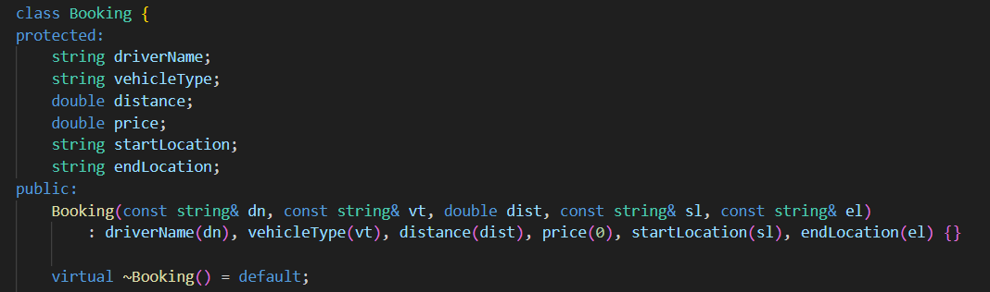
Bundling Data with Behaviour
Grouped related data using struct and Class (User, Driver, Vehicle) for organized data handling.
Used private members in custom exception classes (e.g., RatingException) to hide internal data.
Validated input through functions like getValidInput<T>() and validatePhone() to ensure safe access.
Encapsulated file operations (loadDrivers(), saveUserProfile()) for clean abstraction.
Profile updates and history saving are done via public methods, not direct access.

Slide 11
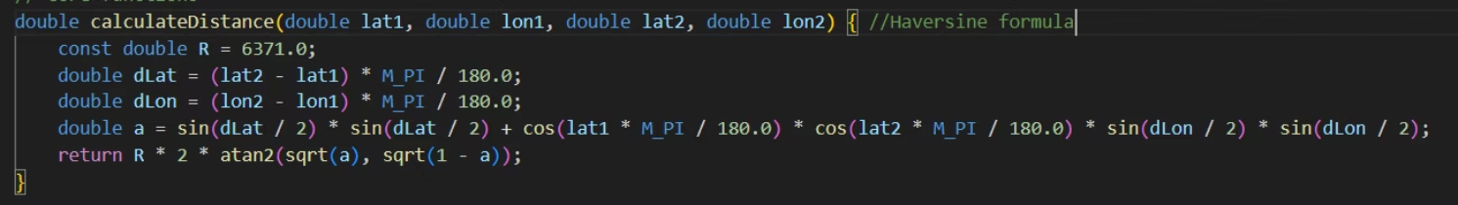
Hiding Complexity
How We Used It:
The Haversine formula calculates real-world distance between two geographic points (latitude & longitude).
It is implemented in a separate function
Users just need distance, not the math

Slide 12
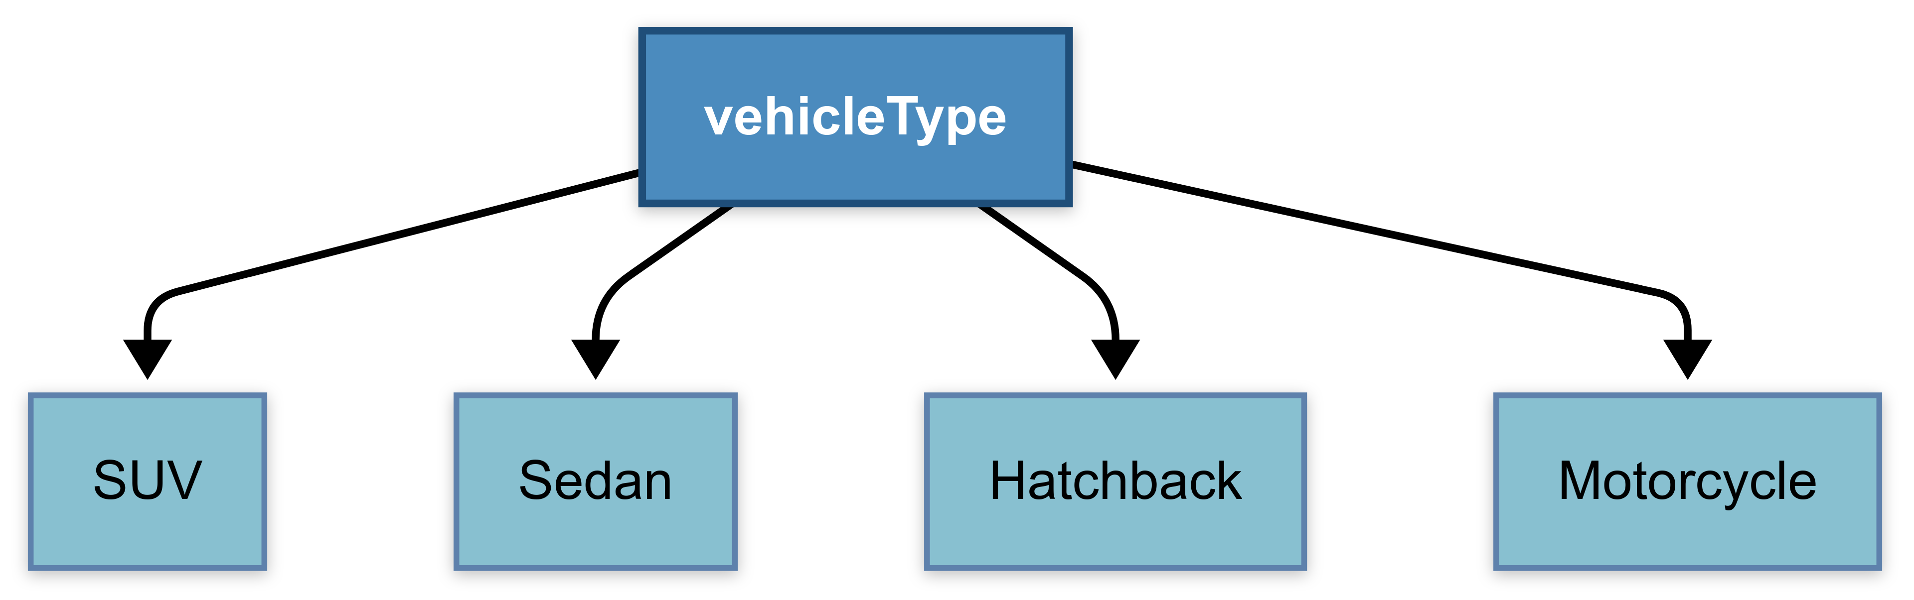
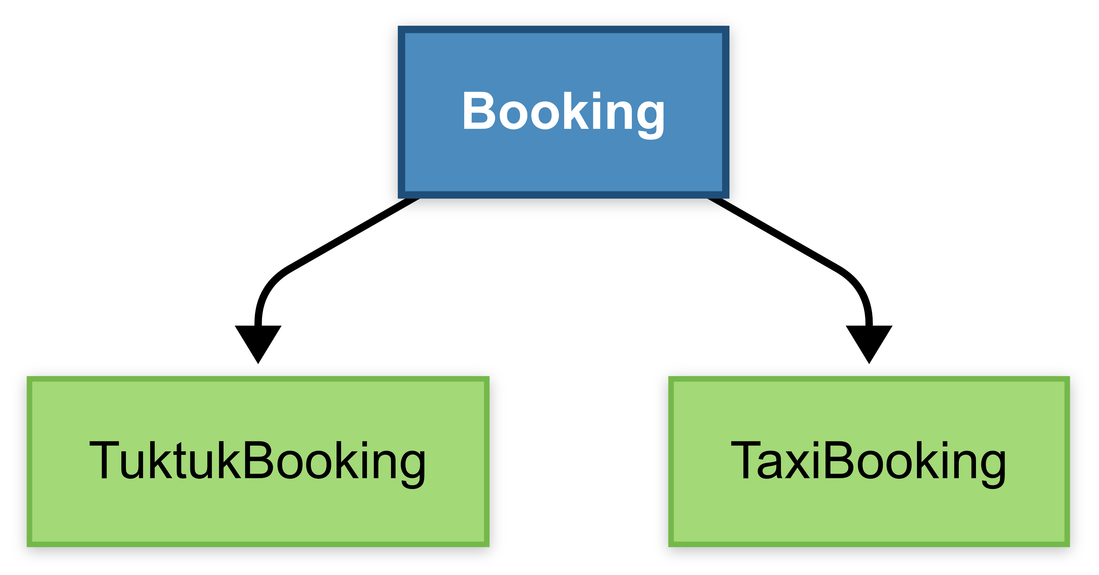
Inheritance: Write less, do more
Used Hierarchal Inheritance in:
Vehicle Rental Hierarchy:
2. Booking System Hierarchy:

Slide 13
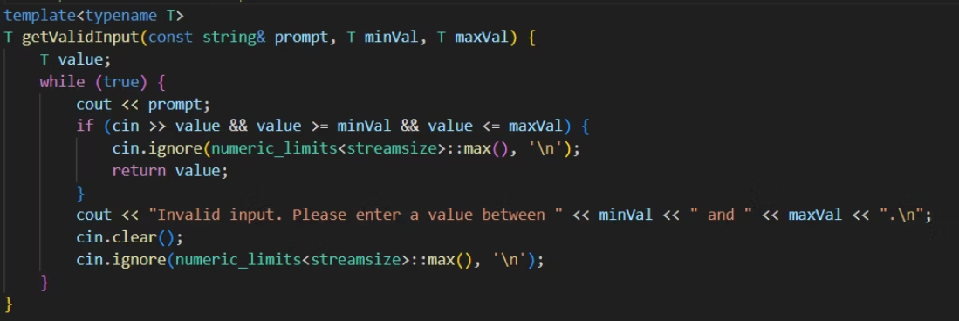
Flexible Input Handling with Templates
Templates allow writing generic and reusable functions or classes that work with any data type. They enable compile-time polymorphism, where the compiler generates type-specific versions as needed
Usage in Our Project:
We implemented a template function getValidInput<T>() to handle user input validation for multiple types like int, double, etc.
This eliminates the need to write separate functions for each type.

Slide 14
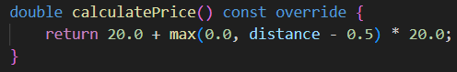
Virtual Functions: Polymorphism
Virtual Function:
A function in a base class marked with virtual, allowing derived classes to override it.
virtual double calculatePrice() const; // Base class (Booking)
Run-time Decision:
The correct function is chosen at runtime based on the object’s actual type.
Booking* booking = new TuktukBooking(...); booking->calculatePrice(); // Calls TuktukBooking's version

Slide 15
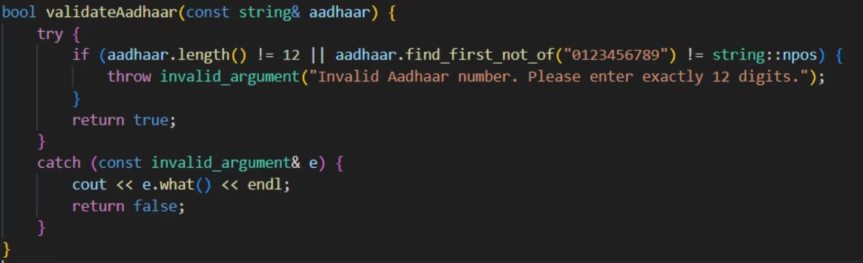
Effective Error Management
Exception handling allows programs to manage errors without crashing. It uses three key constructs:
try: Defines code that may throw an exception.
throw: Signals an error condition.
catch: Handles the exception and takes corrective action.

Slide 16
Built for the present, ready for the future.
Future Enhancements:
🖥️ GUI Integration – Shift to Qt-based interfaces
🗄️ Database Upgrade – Migrate from CSV to SQLite/MySQL
📍 Real-Time Features – Live tracking, surge pricing
🤖 AI Integration – Smart suggestions based on usage trends
💳 Payment Modules – In-app payments & loyalty rewards
This Cab Booking and Vehicle Rental System, built using modern C++ and Object-Oriented Programming principles, represents more than just a functional console application—it is a well-structured response to real-world mobility challenges tailored specifically for Silchar, the cultural and academic hub of Assam and home to NIT Silchar.

Slide 17
THANK YOU

